Slide 1
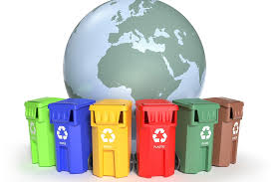
What should you have?
You must have three different containers or boxes for cardboard and paper, plastics, glass in addition to the garbage can for organic.
To go doing everything in its place.

